Slide 1

PriceRewind
1970s, 1980s, 1990s, 2000s, 2010s
enrichmentality.com

Slide 2
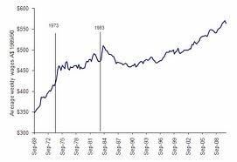
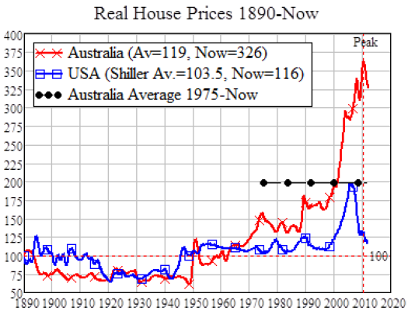
INCOME & house prices
1970
now
1970
now
Incomes are
1.6x more
Houses
cost 3x
more
enrichmentality.com

Slide 3
How much do you think prices of consumer goods have increased between…
1977 and today? _____x
1987 and today? _____x
1997 and today? _____x
2007 and today? _____x
enrichmentality.com

Slide 4
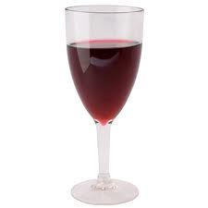
Acrylic wineglass (1986 vs 2012)
75c ea
2012
99c ea
1986
enrichmentality.com

Slide 5
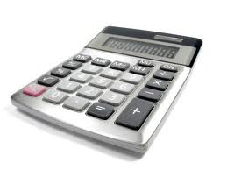
Calculator (1991 vs 2012)
$3.95
1991
$3.49
2012
enrichmentality.com

Slide 6
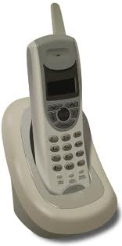
A cordless phone costs $19 now.
How much did it cost in 1991?
$_________________________
$179
enrichmentality.com

Slide 7
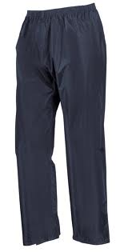
PANTS (1977 vs 2012)
$8.00
2012
$8.98
1977
enrichmentality.com

Slide 8
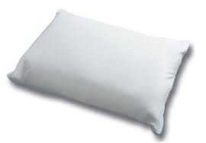
A Pillow cost $5.98 in 1987.
What is the cheapest you can
buy a new pillow for at Big W
today?
$_________________________
$3
enrichmentality.com

Slide 9

Razzamatazz stockings (1989 vs. 2012)
99c
1989
$8.41
2012
enrichmentality.com

Slide 10
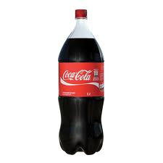
2L coke (1988 vs 2012)
$1.49
2012
$1.50
1988
enrichmentality.com

Slide 11
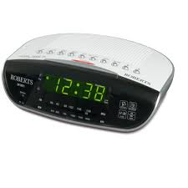
Clock Radio (1980 vs 2012)
$17.99
2012
$26.99
1980
enrichmentality.com

Slide 12

COMPUTER (1980 vs 2012)
$1995
1991
(40Mb)
$399
2012
(320Gb)
enrichmentality.com

Slide 13
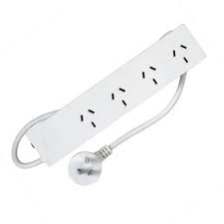
A Powerboard costs $4.99 now.
How much did it cost in 1991?
$_________________________
$7.95
enrichmentality.com

Slide 14
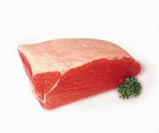
Corned Silverside (84, 87 vs 2012)
$7.49/kg
1984
$7.59/kg
1987
$5.99/kg
2012
enrichmentality.com

Slide 15
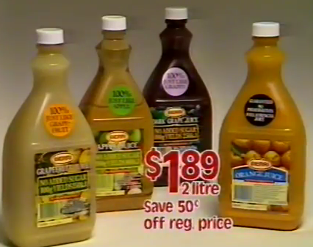
A bottle of Berri juice contained 2L in 1984.
Do you get more or less now?
2.4L - more
enrichmentality.com

Slide 16
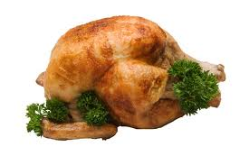
BBQ Chicken (84, 85 vs. 2012)
$4.39
1984
$3.49
1985
$9.98
2012
enrichmentality.com

Slide 17
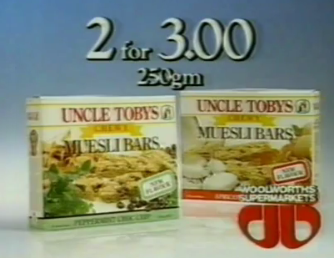
6x uncle toby’s museli bars weighed 250g In 1986
Do you get more or less now?
185g - less
enrichmentality.com

Slide 18
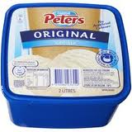
Peter’s Icecream (1987 vs 2012)
$2.15
2012
$4.68
1987
enrichmentality.com

Slide 19
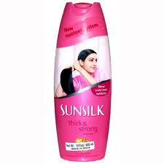
Sunsilk Shampoo cost $1.50 per 100ml in 1986.
How much does it cost now?
$_________________________
$1.25 per 100ml
enrichmentality.com

Slide 20
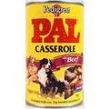
PAL dog food (1986 vs. 2012)
69c
1986
$2.19
2012
enrichmentality.com

Slide 21

Middle Bacon Cost $7.29/kg in 1986
How much is it at Coles now?
$_________________________
$7.99/kg
enrichmentality.com

Slide 22
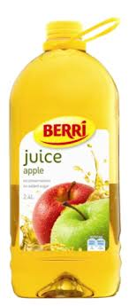
Berri Juice Per/L (84,85,90 vs 2012)
$1.20
1984
$1.25
2012
$1.32
1985
$1.43
1990
enrichmentality.com

Slide 23
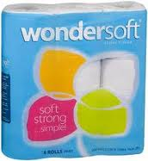
Wondersoft Toilet paper cost 57c a roll in 1988
How much does it cost now?
$_________________________
46c
enrichmentality.com

Slide 24
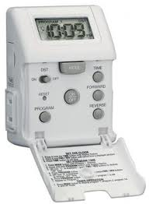
Light Timer (1983 vs 2012)
$19
1983
$14
2012
enrichmentality.com

Slide 25
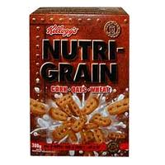
Nutrigrain costs 62c per 100g now.
How much did it cost in 1988?
$_________________________
62c per 100g
enrichmentality.com

Slide 26
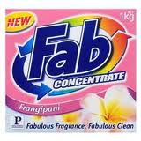
FAB (1986, 1998 vs 2012) (same number of loads)
$1.50
2012
$3.99
1986
$6.98
1998
enrichmentality.com

Slide 27
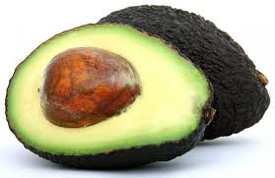
An avocado costs $2.98 now.
How much did it cost in 1984,
and what was it known as?
$_________________________
79c, avocado pear
enrichmentality.com

Slide 28
Not including the computer…
Purchasing 100 items advertised over the 70s, 80s, or 90s would cost $197 less today.
If you substitute Homebrand items where available, it is actually $280 less now.
Things (at least on this list) actually cost 0.23x LESS than they were 20-30 years ago.
enrichmentality.com

